Slide 1



Project no.
Project Proposal
Title: Purple Oven by Malou
Team members and roles:
Me, myself and I
Powered by

Slide 2


Project Description
Briefly introduce the project
Who is the target end user?
What are the objectives?
The target of the Purple Oven by Malou is the people who wants to buy baked goods that are freshly made and ready to get delivered within a designated time.
The objective of Purple Oven by Malou is to make the life of the consumers easier whenever they want to order products from Purple Oven by Malou.
Powered by

Slide 3
Define Deliverables and Goals
Present the project timeline
Set goals that align with the deliverables you’re producing
Feb 11 – Feb 12: Completing Website Sketch (Completing Phase 1 and Phase 2)
Feb 13 – Feb 14: Searching for Website Information
Feb 15 – Feb 21: Building the Website (Completing Phase 3)
Feb 22 – Feb 24: Getting Feedback Feb 25 – Feb 26: Applying Feedback Feb 27: Presenting Final Output (Completing Phase 4)
Powered by

Slide 4
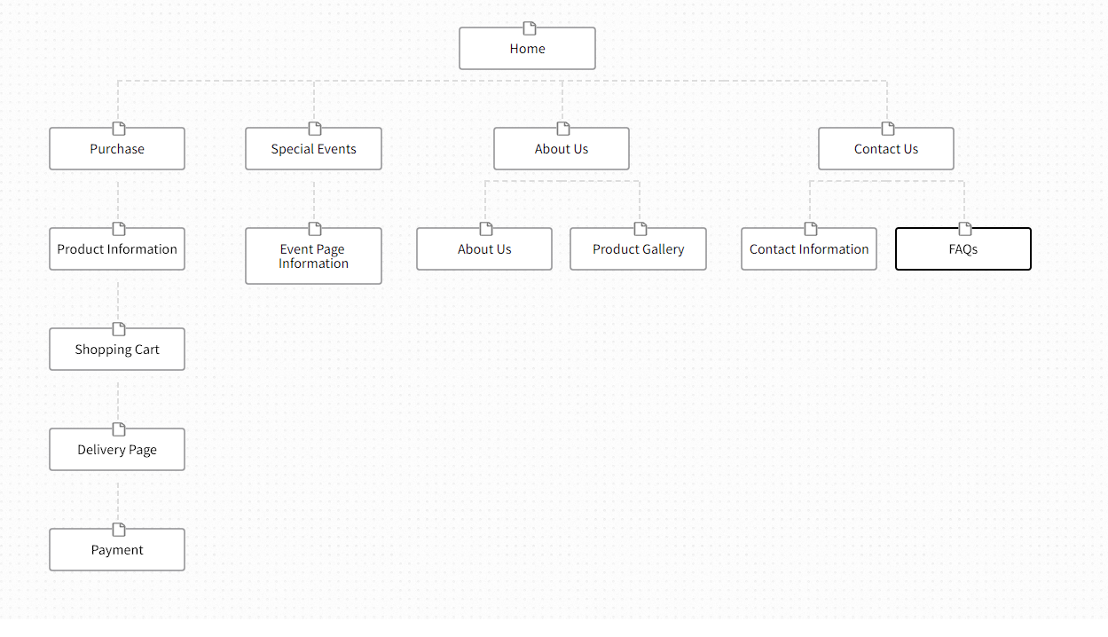
Hierarchical Sitemap of your Website
Information architecture of a website
Visual representation of the site’s organization and how different sections are linked together.
Powered by

